Slide 1
Introduction to Options 2
Amherst College Quantitative Trading Club, October 19th, 2020

Slide 2
Announcements
Aperture
We are excited to announce that we have partnered with Citadel to launch a simulated trading platform for Amherst College students!
If you are interested in participating (not required, but recommended) here are some basic rules you should know
Everyone who signs up must submit 5 trade ideas per “period” (quarter) at minimum. We would strongly prefer you to submit way more than 5 ideas.
“Ideas” can be fundamental (ie, researching specific tickers and making an investment decision) or quantitative (more algorithmic in nature).
There are individual and team-based monetary prizes for the highest performing teams/individuals. Individuals can also receive an interview opportunity with Citadel.
We will periodically check in with everyone who signed up to ensure that ideas are being entered into the platform.

Slide 3
Brainteaser of the Week
You are facing two doors. One leads to your job offer and the other leads to the exit. In front of either door is a guard. One guard always lies, while the other guard always tells the truth. You do not know which guard is situated in front of each door. You can only ask one guard one yes/no question. Assuming you do want to get the job offer, what question will you ask?

Slide 4
Answer
There are several possibilities. Standard one is, “Would the other guard say that you are guarding the door to the offer?” If he answers yes, choose the other door, otherwise, choose that door. Any question that makes the two guards reveal the other’s identity would work.

Slide 5
Review: What is an Option?
The right to take an action
Owning an option gives you that right
Selling an option means you sold your rights to a counterparty, so you are left with an obligation to fulfill those rights
Call – Right to buy underlying at a specified strike
Put – Right to sell underlying at a specified strike

Slide 6
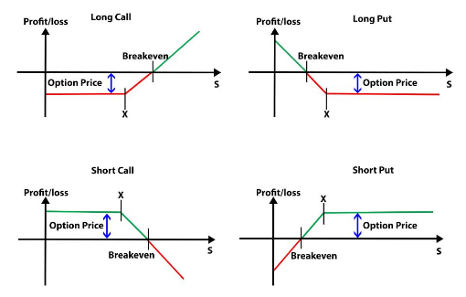
Source: Quantra
Review: Option Payoff
An option payoff diagram is a graphical representation of the net Profit/Loss made by the option buyers and sellers.
S = Underlying Price
X = Strike Price
A break even point is the point at which you make no profit or no loss. Option Premium is the upfront payment made by the option buyer to the option seller to acquire the option.
Notes:
https://www.khanacademy.org/economics-finance-domain/core-finance/derivative-securities/put-call-options/v/put-payoff-diagram
https://quantra.quantinsti.com/glossary/Option-Payoff

Slide 7
Some Jargons (Sheldon Chapter 3)
Intrinsic Value
An option has intrinsic value if it enables the holder of the option to buy low and sell high or sell high and buy low, with the intrinsic value being equal to the difference between the buying price and the selling price.
With an underlying contract trading at $435, the intrinsic value of a 400 call is $35. By exercising the option, the holder of the 400 call can buy at $400. If he then sells at the market price of $435, $35 will be credited to his account. With an underlying contract trading at $62, the intrinsic value of a 70 put is $8. By exercising the option, the holder of the put can sell at $70. If he then buys at the market price of $62, he will show a total credit of $8.

Slide 8
Some Jargons
Time Value
Sometimes also referred to as the option’s time premium or extrinsic value, is the additional amount of premium beyond the intrinsic value that traders are willing to pay for an option. Market participants are willing to pay this additional amount primarily because of the protective characteristics afforded by an option over an outright long or short position in the underlying contract. (Sheldon Chapter 3)
Intrinsic Value
Value
Time Value
Strike

Slide 9
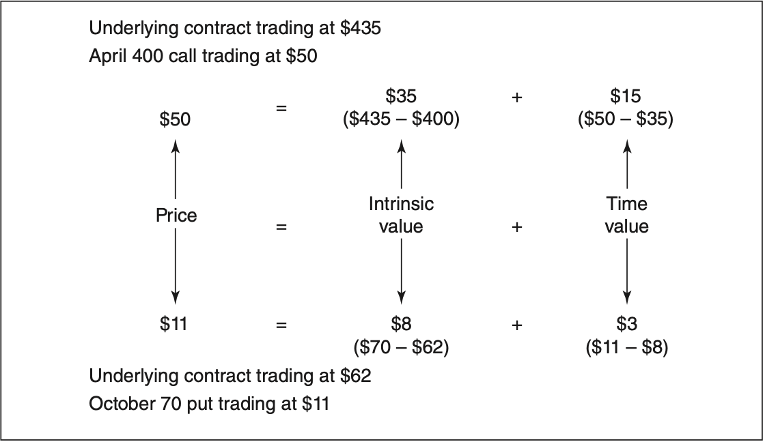
Premium = Price = Intrinsic Value + Time Value (both can be 0)

Slide 10
Some Jargons
In the Money
Any option that has a positive intrinsic value is said to be in the money by the amount of the intrinsic value.
With a stock at $44, a $40 call is in the money by $4. A $55 put on the same stock is in the money by $11.
In order to be in the money, a call must have an exercise price lower than the current price of the underlying contract, and a put must have an exercise price higher than the current price of the underlying contract.
Intrinsic Value
Value
Time Value
Strike

Slide 11
Some Jargons
Out of the Money
An option with no intrinsic value is said to be out of the money, and its price consists solely of time value.
At the Money
An option whose exercise price is equal to the current price of the underlying contract is said to be at the money. Technically, such an option is also out of the money because it has no intrinsic value. Traders make the distinction between at-the-money and out-of-the-money options because at-the-money options often have very specific and desirable characteristics, and such options tend to be the most actively traded.
Intrinsic Value
Value
Time Value
Strike

Slide 12
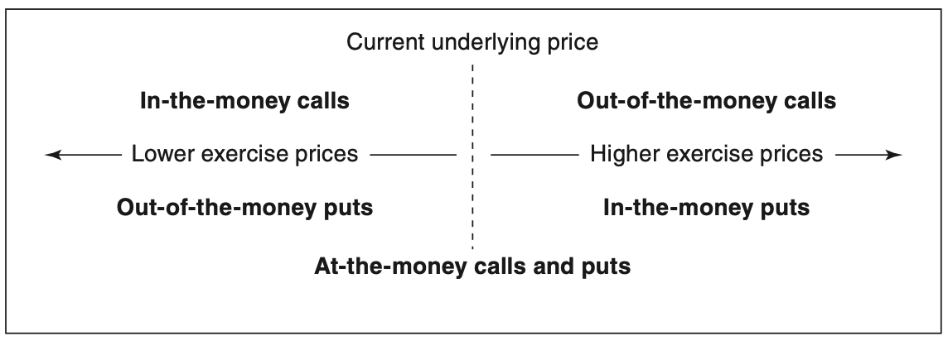
In the Money, At the Money, and Out of the Money

Slide 13
Volatility (Sheldon Chapter 6)
What are options traders interested in?

Slide 14
Volatility (Sheldon Chapter 6)
What are options traders interested in?
Direction of the market
Speed of the market
If the market for an underlying contract fails to move at a sufficient speed, options on that contract will have less value because of the reduced likelihood of the market going through an option’s exercise price.
Volatility is a measure of the speed of the market.
Markets that move slowly are low-volatility markets; markets that move quickly are high-volatility markets.
How to quantify Volatility?
Need to convey this information to a theoretical pricing model based on mathematical formulas
We will need some method of quantifying this volatility component so that we can feed it into the model in numerical form.

Slide 15
Volatility
Vol is a trader’s term for standard deviation
Realized Volatility - associated with an underlying contact
Implied Volatility - associated with options

Slide 16
Volatility
Vol is a trader’s term for standard deviation
Realized Volatility = measure of past volatility of an underlying contract over a period
the annualized standard deviation of percent price changes of an underlying contract over some period of time.
The future realized volatility describes the future distribution of price changes for an underlying contract.
If a trader intends to use a theoretical pricing model, he/she must try to make an estimate of future realized volatility. In option evaluation, a good starting point is historical data.

Slide 17
Volatility
Vol is a trader’s term for standard deviation
Implied Volatility = price quoted for options. It’s roughly the expected volatility over the life of the option within a 1 standard deviation confidence interval.
Bought at 27.51 percent instead of 5 dollars
As bids and offers are made, the price at which an option is trading will represent an equilibrium between supply and demand. This equilibrium can be expressed as an implied volatility.

Slide 18
Volatility
The future realized volatility - value of options on that contract.
The implied volatility - an option’s price.
If implied volatility is low with respect to the expected future volatility, a trader will prefer to buy options; if implied volatility is high, a trader will prefer to sell options. Of course, future volatility is an unknown, so a trader will look at historical and, if available, forecast volatility to help in making an intelligent guess about the future. In the final analysis, though, it is the future realized vola- tility that determines an option’s value.

Slide 19

Next Time...
Greeks
Put-Call Parity

